Slide 1
Version Control and GitHub
Andrew T. Pipo
Lead-TA
UC Blue Ash, Spring 2025

Slide 2
Version Control
A system that tracks changes to files over a period of time
Git is a distributed version control system
Allows multiple developers to work on the same project while keeping history

Slide 3
Git Repository
A central location where all the files, code, and revision history of a project are stored
Can be public or private
Public repositories are accessible to the public
Private repositories are only accessible to the owner and select people
Can track changes and maintain history, allowing developers to revert back if needed

Slide 4
Branches and Merging
A branch is a parallel version of a given code that developers can create to work on different functionality
Branches allow experimentation without affecting the main set of code
Branches can be merged into one another or back into the main branch when done
Merging is when parallel versions of a given code are combined with the different changes and history

Slide 5
Local and Remote Repositories
Local Repositories are repositories that are stored on a local computer
Remote Repositories are repositories that are stored on a public service (GitHub)

Slide 6
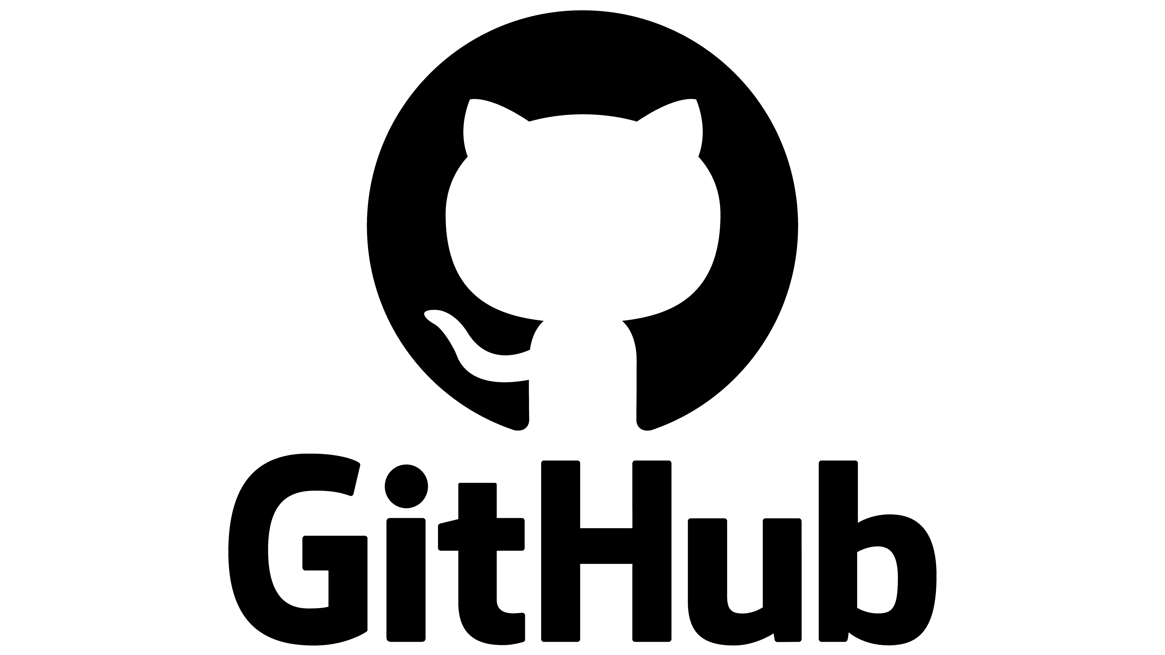
What is GitHub
A platform that hosts git repositories
Allows developers to host, share, and collaborate projects (code)

Slide 7
Cloning
Cloning is downloading a full copy of a repository from a remote (GitHub) repo to your local machine/device

Slide 8
Forking
Forking is when you create a new repository that shares the same code and visibility settings as the original repository

Slide 9
Pull Requests
A Pull Request is part of the merging process for branches
A proposal of changes from one branch to be merged into another
Allows developers to review changes for critique/feedback and to collaborate

Slide 10
Issues
Issues are used on GitHub for repository management
Collect user feedback
Reporting Bugs
Organizing Project Tasks

